Slide 1
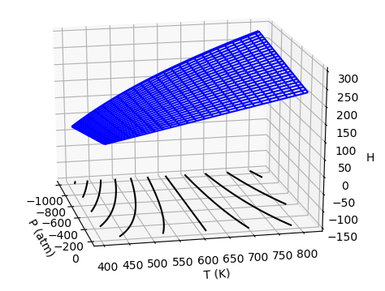
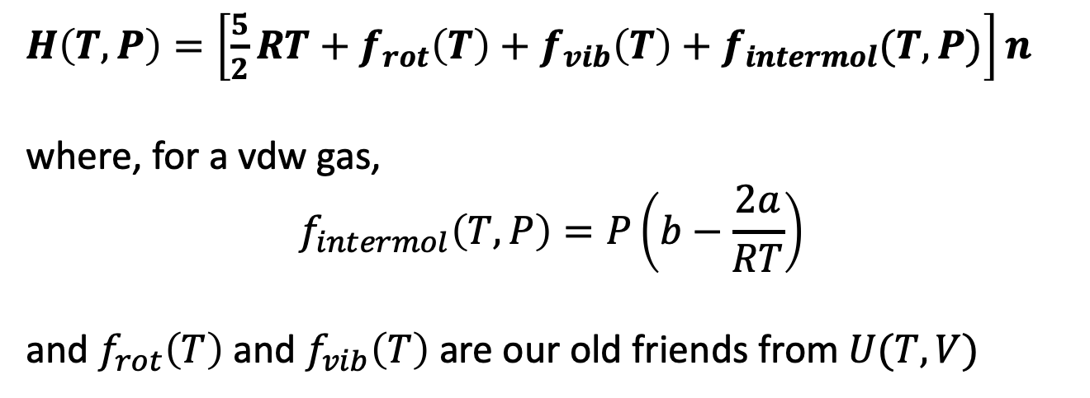
Last time: Introduced the Enthalpy, $H$
$H\left(T,P\right)=\left[\frac{5}{2}RT+f_{rot}\left(T\right)+f_{vib}\left(T\right)+f_{intermol}(T,P)\right]n$
where, for a vdw gas,
$$f_{intermol}\left(T,P\right)=P\left(b−\frac{2a}{RT}\right)$$
and $f_{rot}\left(T\right)$ and $f_{vib}\left(T\right)$ are our old friends from $U(T,V)$

Slide 2
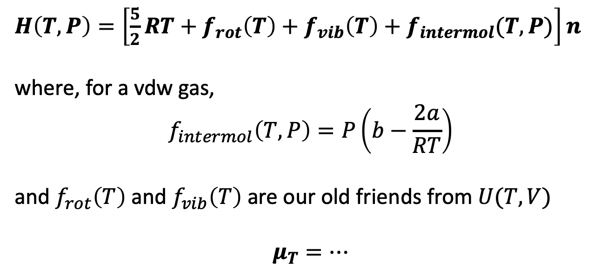
Let’s take this one more step and predict $μ_{T}$ for a vdw gas
$H\left(T,P\right)=\left[\frac{5}{2}RT+f_{rot}\left(T\right)+f_{vib}\left(T\right)+f_{intermol}(T,P)\right]n$
where, for a vdw gas,
$$f_{intermol}\left(T,P\right)=P\left(b−\frac{2a}{RT}\right)$$
and $f_{rot}\left(T\right)$ and $f_{vib}\left(T\right)$ are our old friends from $U(T,V)$
$$μ_{T}=…$$

Slide 3
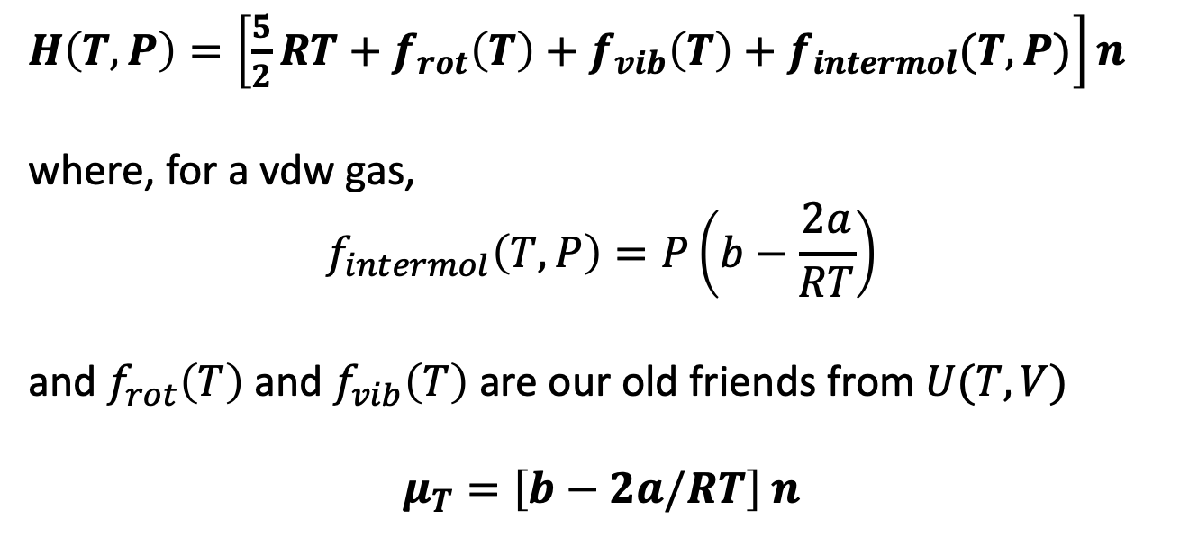
Let’s take this one more step and predict $μ_{T}$ for a vdw gas
$H\left(T,P\right)=\left[\frac{5}{2}RT+f_{rot}\left(T\right)+f_{vib}\left(T\right)+f_{intermol}(T,P)\right]n$
where, for a vdw gas,
$$f_{intermol}\left(T,P\right)=P\left(b−\frac{2a}{RT}\right)$$
and $f_{rot}\left(T\right)$ and $f_{vib}\left(T\right)$ are our old friends from $U(T,V)$
$$μ_{T}=\left[b−2a/RT\right] n$$

Slide 4
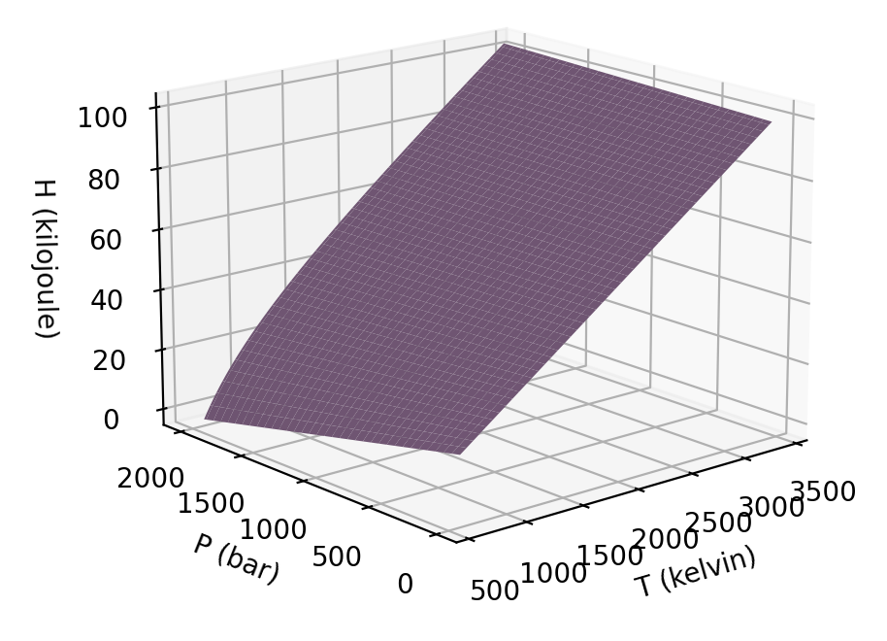
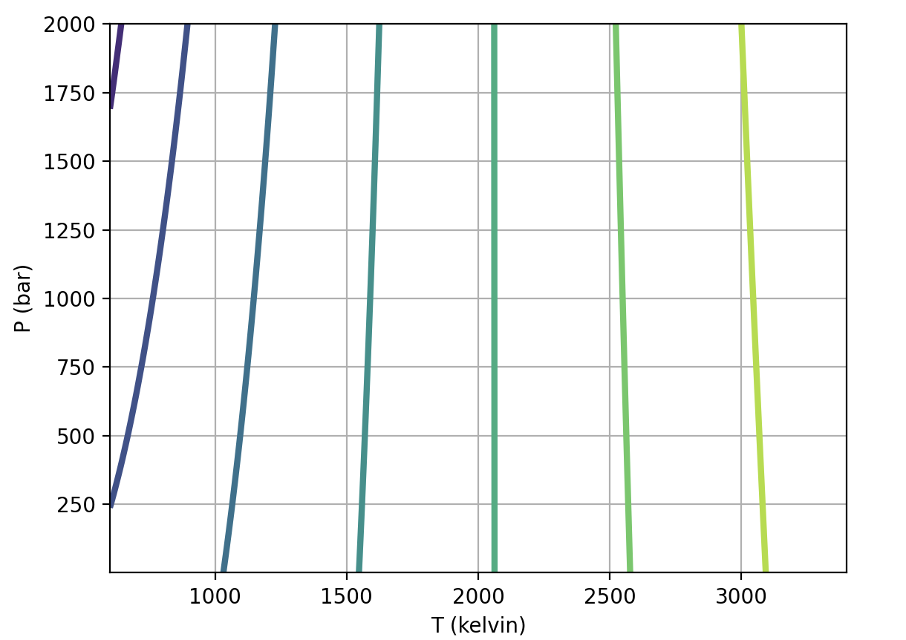
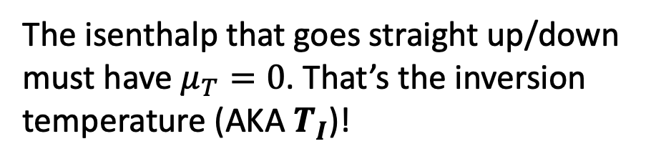
We also talked about isenthalps, the twist, and $T_{I}$
The isenthalp that goes straight up/down must have $μ_{T}=0$. That’s the inversion temperature (AKA $T_{I}$)!

Slide 5
Let’s take this one more step and predict $μ_{T}$ for a vdw gas, using $μ_{T}=\left[b−2a/RT\right] n$
The isenthalp that goes straight up/down must have $μ_{T}=0$. That’s the inversion temperature (AKA $T_{I}$)!

Slide 6

Let’s take this one more step and predict $μ_{T}$ for a vdw gas, using $μ_{T}=\left[b−2a/RT\right] n$
$$T_{I}=2\frac{a}{Rb}$$
The isenthalp that goes straight up/down must have $μ_{T}=0$. That’s the inversion temperature (AKA $T_{I}$)!

Slide 7
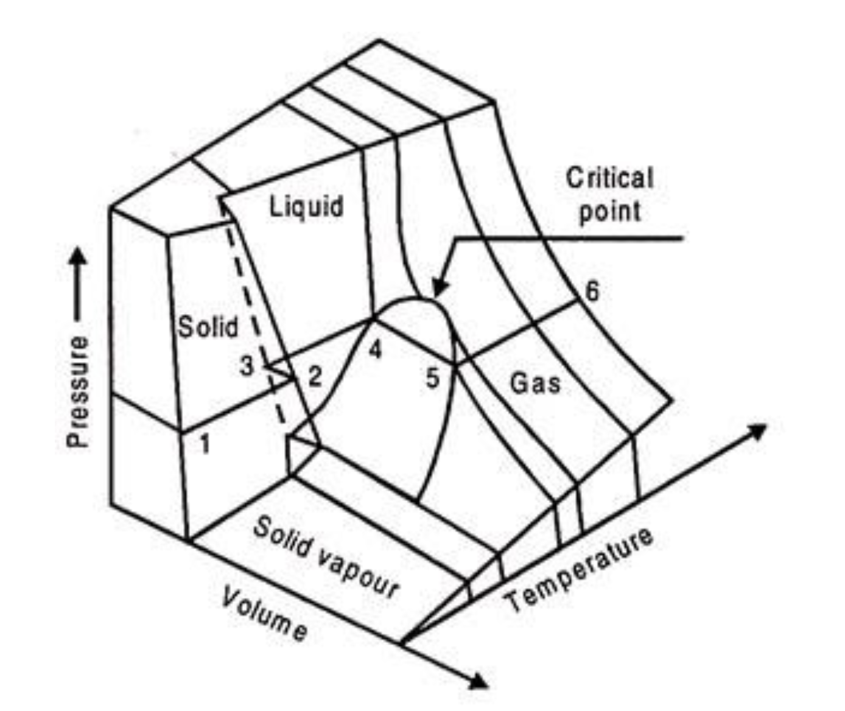
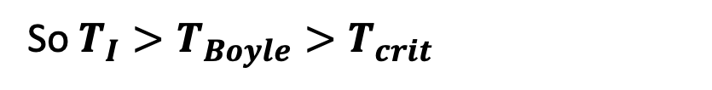


Remember we talked about $\frac{a}{Rb}$ as a unifying idea
$$T_{I}≈2\frac{a}{Rb}$$
$T_{Boyle}≈\frac{a}{Rb}$
$T_{crit}≈\frac{1}{3}\frac{a}{Rb}$
So $T_{I}>T_{Boyle}>T_{crit}$
https://www.engineeringenotes.com/thermal-engineering/real-gases/real-gases-properties-van-der-waals-equation-and-equation-of-state-thermal-engineering/49112

Slide 8
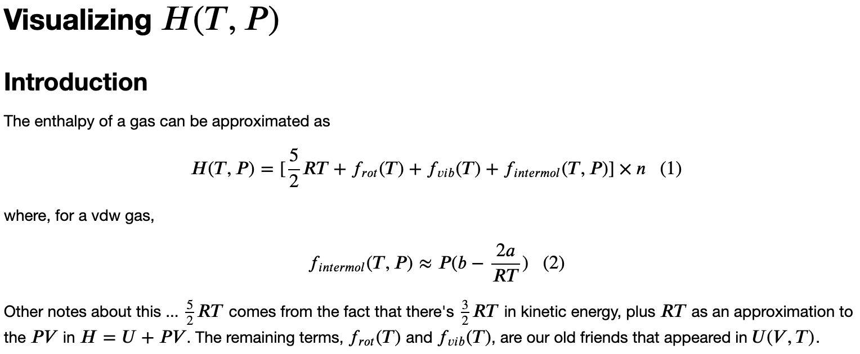
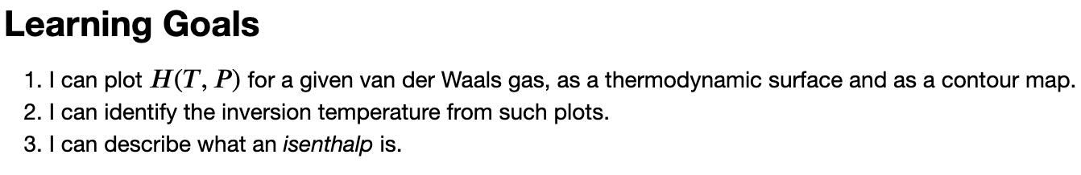
Let’s work on this for a while …

Slide 9
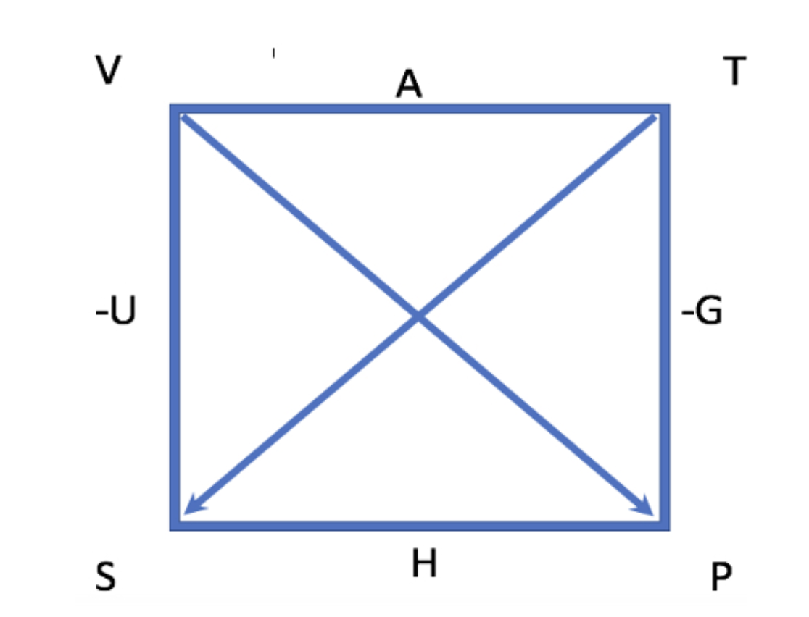
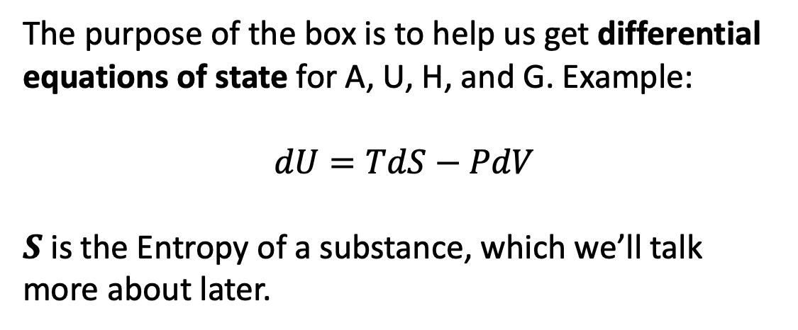
Introducing The Box
The purpose of the box is to help us get differential equations of state for A, U, H, and G. Example:
$$dU=TdS−PdV$$
$S$ is the Entropy of a substance, which we’ll talk more about later.
Our first task: Derive differential equations of state for U, A, H, and G.

Slide 10
Using differential equations of state to get slopes of $U$
Since $dU=TdS−PdV$, we can say ${\left(\frac{∂U}{∂S}\right)}_{V}=T{\left(\frac{∂S}{∂S}\right)}_{V}−P$ ${\left(\frac{∂V}{∂S}\right)}_{V}=T(1)−P (0)=T$

Slide 11
Blackboard work: Use differential equations of state to get slopes of $G$
$dG=VdP−SdT$, so we can say ${\left(\frac{∂G}{∂P}\right)}_{T}=…$

Slide 12
Blackboard work: Use differential equations of state to get slopes of $G$
$dG=VdP−SdT$, so we can say ${\left(\frac{∂G}{∂P}\right)}_{T}=V{\left(\frac{∂P}{∂P}\right)}_{T}−\text{S} {\left(\frac{∂T}{∂P}\right)}_{T}=V(1)−\text{S} (0)=\text{V}$

Slide 13
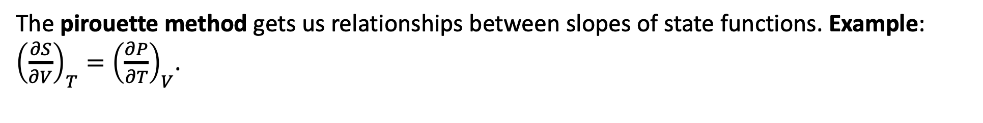
Introducing the pirouette
The pirouette method gets us relationships between slopes of state functions. Example: ${\left(\frac{∂S}{∂V}\right)}_{T}={\left(\frac{∂P}{∂T}\right)}_{V}$.

Slide 14
Blackboard work: Get the other three pirouette relationships. The sign comes into play here.
The pirouette method gets us relationships between slopes of state functions. Example: ${\left(\frac{∂S}{∂V}\right)}_{T}={\left(\frac{∂P}{∂T}\right)}_{V}$.

Slide 15

Maxwell relations are what you get when you do this (there are four of them)
$${\left(\frac{∂S}{∂V}\right)}_{T}={\left(\frac{∂P}{∂T}\right)}_{V}$$
$${\left(\frac{∂V}{∂T}\right)}_{P}={−\left(\frac{∂S}{∂P}\right)}_{T}$$
(+ two more)

Slide 16
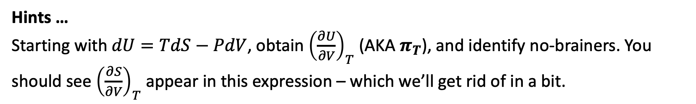
Blackboard work: Use The Box to generate an expression for $π_{T}$
Hints …
Starting with $dU=TdS−PdV$, obtain ${\left(\frac{∂U}{∂V}\right)}_{T}$ (AKA $π_{T}$), and identify no-brainers. You should see ${\left(\frac{∂S}{∂V}\right)}_{T}$ appear in this expression – which we’ll get rid of in a bit.

Slide 17
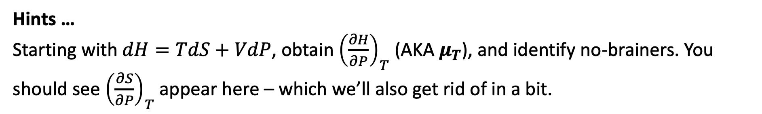
Blackboard work: Use The Box to generate an expression for $μ_{T}$
Hints …
Starting with $dH=TdS+VdP$, obtain ${\left(\frac{∂H}{∂P}\right)}_{T}$ (AKA $μ_{T}$), and identify no-brainers. You should see ${\left(\frac{∂S}{∂P}\right)}_{T}$ appear here – which we’ll also get rid of in a bit.

Slide 18
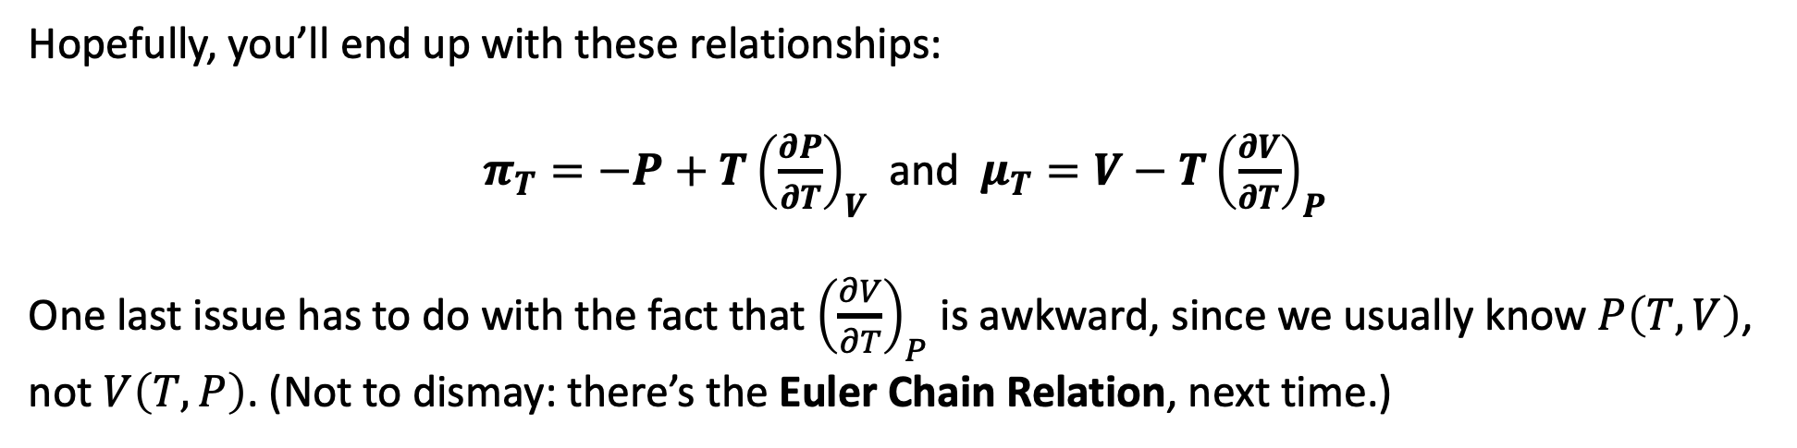
Blackboard work: Results for $π_{T}$ and $μ_{T}$
Hopefully, you’ll end up with these relationships:
$π_{T}={−P+T\left(\frac{∂P}{∂T}\right)}_{V}$ and $μ_{T}={V−T\left(\frac{∂V}{∂T}\right)}_{P}$
One last issue has to do with the fact that ${\left(\frac{∂V}{∂T}\right)}_{P}$ is awkward, since we usually know $P\left(T,V\right)$, not $V\left(T,P\right)$. (Not to dismay: there’s the Euler Chain Relation, next time.)

